Slide 1





RIMS MCA Major Project Group 3 – 02nd July 2022
Internal Guide –
Lipika Rajanandini Sahu, Asst. Professor, RIMS, Rourkela
External Guide –
Biswaranjan Mandoi – Senior Manager, L&T Infotech, UK
Suvendu Mishra – Practice Lead, Cytiva, Bangalore

Slide 2
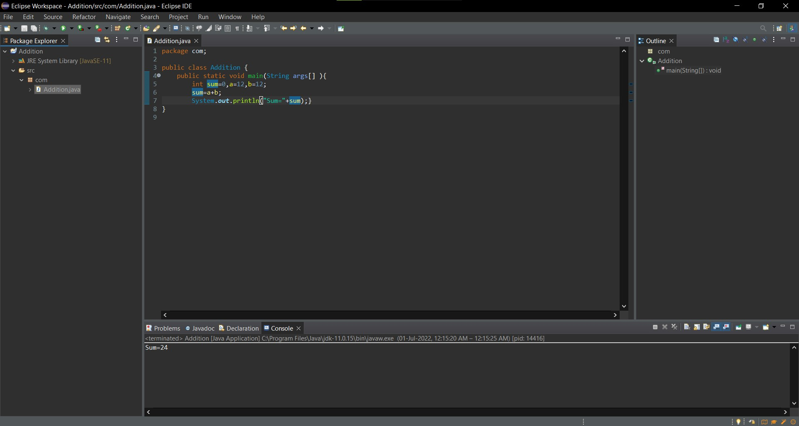
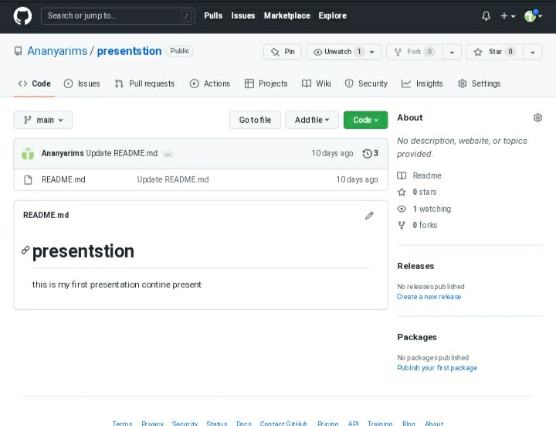
Summary – Green Store : An e-commerce application to sell different varieties of plant through B2B platform.
Accomplishment –
SRS updated with Non-functional requirements and sign-off – Completed
Internal Training on Git/GitHub, Eclipse IDE to project members by Ananya and Satyajit - Completed.
GANTT chart of the Project - Completed
Draft skeleton of project’s modules (Front-end, back-end and integration layer – In-progress
Help Needed –
None for this week.
Plan for Next Week –
Internal training on MAVEN/ JUNIT by Amitesh & Jagannath
B2B concepts learning and presentation
Schedule session with External Enterprise Architect to prepare the Use Case Diagram and Class Diagram of the project

Slide 3
